Slide 1



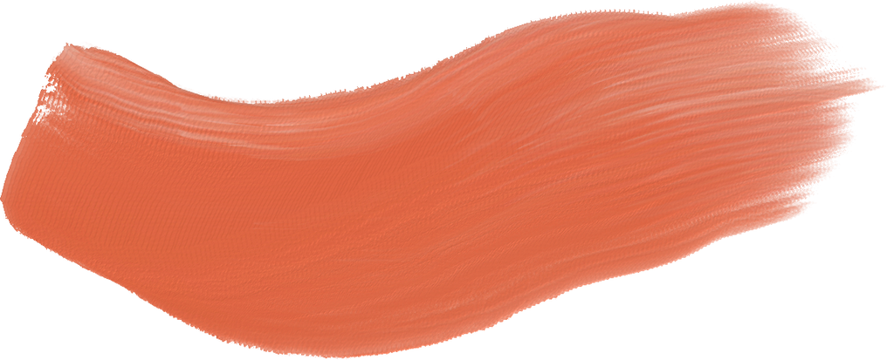








FEAR
SELF-DOUBT
DREAD
LOATHING

Slide 2
OZYMANDIAS
BY PERCY BYSSHE SHELLEY
I met a traveler from an antique land
Who said: Two vast and trunkless legs of stone
Stand in the desert . . . Near them, on the sand,
Half sunk, a shattered visage lies, whose frown,
And wrinkled lip, and sneer of cold command,
Tell that its sculptor well those passions read
Which yet survive, stamped on these lifeless things,
The hand that mocked them, and the heart that fed:
And on the pedestal these words appear:
"My name is Ozymandias, king of kings:
Look on my words, ye Mighty, and despair!"
Nothing beside remains. Round the decay
Of that colossal wreck, boundless and bare
The lone and level sands stretch far away.

Slide 3


To a Waterfowl
by William Cullen Bryant
Whither, 'midst falling dew,
While glow the heavens with the last steps of day,
Far, through their rosy depths, dost thou pursue
Thy solitary way?
. . .

Slide 4
HOW DID YOU LEARN POETRY?
•Read the poem -- Take notes on:
•the poet
•the literary movement
•the poetic terms: form, rhyme scheme, meter, simile, metaphor, theme
•what we “should know” about this poem
•the “meaning” of the poem

Slide 5

Does this poem invite your students in?
OR SEND
THEM
RUNNING
FOR
COVER
?

Slide 6



LIFE-CHANGING ADVICE for this teacher of poetry:
Teaching Poetry in High School
by Albert B. Somers
The Literature Workshop
by Sheridan Blau

Slide 7
ZIMMER'S HEAD THUDDING AGAINST THE BLACKBOARD
by Paul Zimmer
At the blackboard I had missed
Five number problems in a row,
And was about to foul a sixth
When the old, exasperated nun
Began to pound my head against
My six mistakes. When I wept,
She threw me back into my seat,
Where I hid my head and swore
That very day I'd be a poet,
And curse her yellow teeth with this.

Slide 8


LET’S TALK ABOUT THIS POEM
As far as you can tell, what's going on in this poem?
What do you notice?
Name a feeling that this poem evokes.
Point out some loaded words.
What questions does the poem raise?

Slide 9



A Small Needful Fact
Is that Eric Garner worked
for some time for the Parks and Rec.
Horticultural Department, which means,
perhaps, that with his very large hands,
perhaps, in all likelihood,
he put gently into the earth
some plants which, most likely,
some of them, in all likelihood,
continue to grow, continue
to do what such plants do, like house
and feed small and necessary creatures,
like being pleasant to touch and smell,
like converting sunlight
into food, like making it easier
for us to breathe.
by Ross Gay
https://poets.org/poet/ross-gay
CURRENT EVENTS CAN BE POETRY.

Slide 10
How did many of us come to know Eric Garner‘s name?
What do you notice in Ross Gay’s poem?
What line stands out to you?
What words does he repeat?
What feelings does this poem stir in you?

Slide 11
There’s a time for more formal teaching.
~ When meeting specific curriculum standards . . .
~ There is value in knowing terms like rhyme, meter, metaphor, simile, stanza, line, imagery.
~ Knowing the language of any discipline enables us to exchange ideas more efficiently.

Slide 12
Preparing students for AP Literature Exam
This is a commitment to college-level poetry study.

Slide 13
[Aeons quest eye on]
By Julie Ezelle-Patton
Aeons quest eye on
prob limp race
Eeeee burrow @ a tomb
well arm'd glossy head Head limp
hearT Never met a muscle couldn't raptivate
H inside y/our dark neat holdshout
R O if ever words would
B Free me
From your open book
Writing in Soil
Heartheartheartearthearth glad to bee
a live wing
I don’t get it either.
But new movements create change.

Slide 14
Studying historically-based literary movements:
How did we get from Ovid to Shelley to Julie Ezelle-Patton?
Or art movements:
How did we get from DaVinci to Mary Cassatt to Andy Warhol to Tracey Emin?
Or music movements:
How did we get from Gregorian Chant to Mozart to Phillip Glass? From Mowtown to Rap?
(P.S. – Gifted students often love this stuff!)

Slide 15
Begin with daily Poetry
No reply required!
What do you notice in this poem?
What’s happening in this poem?
Is there anything puzzling?
Is there a line you really like?
What tone comes through to you?

Slide 16
Can poetry mean whatever you want it to mean?
No.
Does every poem have one authoritative meaning?
No.
Using clues from the text, we might form differing but
valid interpretations of the same poem.

Slide 17
My Papa’s Waltz by Theodore Roethke
The whiskey on your breath
Could make a small boy dizzy;
But I hung on like death:
Such waltzing was not easy.
We romped until the pans
Slid from the kitchen shelf;
My mother’s countenance
Could not unfrown itself.
The hand that held my wrist
Was battered on one knuckle;
At every step you missed
My right ear scraped a buckle.
You beat time on my head
With a palm caked hard by dirt,
Then waltzed me off to bed
Still clinging to your shirt.

Slide 18
In small groups, have students discuss the poem, “My Father’s Waltz”
by Theodore Roethke
Use the previous questions --
What’s going on in this poem?
What do you notice?
etc.
Someone in the group takes notes.
Share your discussion with the class.

Slide 19
Suggestion for Discussion: Poetry Speed Dating
Cluster desks into small groups. Each group has one poem to read -either written on one large sheet of paper or a copy for each. Someone reads it aloud. All then have time to read it silently.
Individuals share comments about the poem:
What do you notice?
What’s happening here?
What puzzles you?
What tone seems to overspread this poem?
Are you left with any questions?
Move to next group.

Slide 20
POETRY SCAVENGER HUNT
FREE POETRY DAY
CLASS ANTHOLOGY
BRING-A-POEM-TO-SCHOOL DAY

Slide 21
Poets to Explore:
Rita Dove
Naomi Shihab Nye
Kwame Alexander
Linda Pastan
Stephen Dunn
Toi Derricotte
Nikki Giovanni
Lucille Clifton
Billy Collins
Ted Kooser
January Gill O’Neil
Ada Limón
Clint Smith
Anele Rubin
Richard Blanco
Mohja Kahf
And so so many more . . .

Slide 22

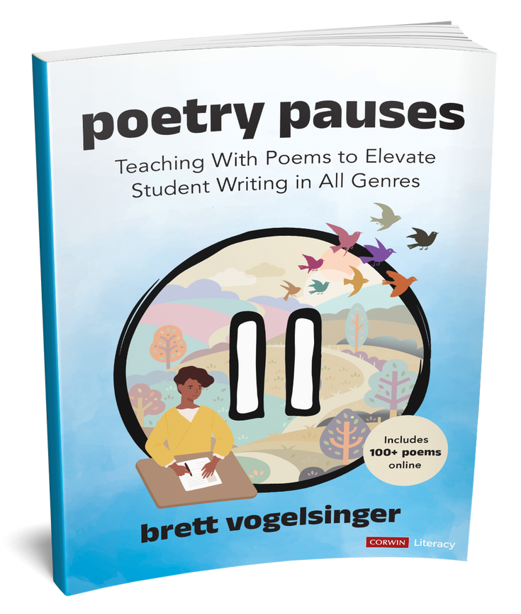
Research
poetry

Slide 23




poets are avid researchrers
SOMETHING I LEARNED
many famous poets publish research
research can be shared poetically

Slide 24

“POETRY AND SCIENCE HAVE GROWN UP TOGETHER AS SIBLINGS . . . THEY ARE CLOSER TOGETHER THAN THEY ARE APART. . . WHEN WE READ A POEM, WE RUN TO THE SCIENCE BOOKS TO FIND OUT MORE. WHEN WE LISTEN TO SCIENCE OR LOOK AT THE STARS, WE RUN INSIDE TO WRITE A POEM”
--ALICIA SOMETIMES
“HONORING YOUR WONDER” TEDX 2020

Slide 25



5
ALTERED AXIS
BY DR. AMY BOYD

Slide 26

2
FIND A FACT
elaborate
with more facts
express
from a perspective
explore
with greater wonder

Slide 27

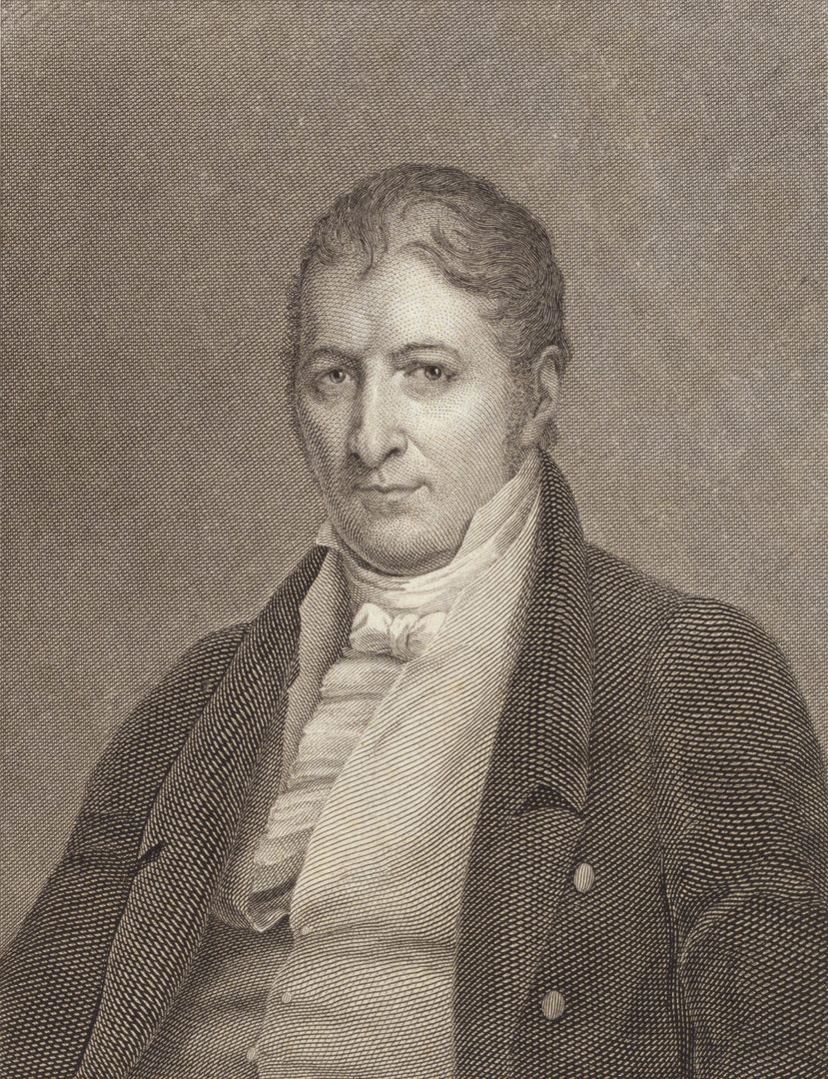
DETERMINATION
BY AMY V, GRADE 8
So interested to see
how that one watch worked,
I lied to my parents
in order to stay home
from church.
I took it apart,
and put it back together,
but I had to hold my excitement back
when my sister came home.
I had to hold my tongue,
not tell her.

Slide 28

4
NEXT STEPS
OR
craft an intro
dig deeper
Move on to writing an introduction with some fresh, poetic diction already in mind.
Avoid getting stuck.
Move back to your research having thought more creatively about your topic.

Slide 29

research paper in verse?

Slide 30

1
YOU TRY IT!
CHOOSE ONE OF THE FACTS BELOW TO CRAFT A SHORT POEM
Facts from Harper's Index, March 2022
  TikTok videos tagged #MentalHealth have been watched 25,100,000,000 times
  7/10 pet owners in the U.S. say they take their pet's health more seriously than their own.
  92 of the 100 most-watched TV broadcasts last year were NFL games.

Slide 31
who is willing to share?

Slide 32
Poems for brainstorming
THAT’S NOT ALL!
poems for writing argument
poems for studying grammar

Slide 33

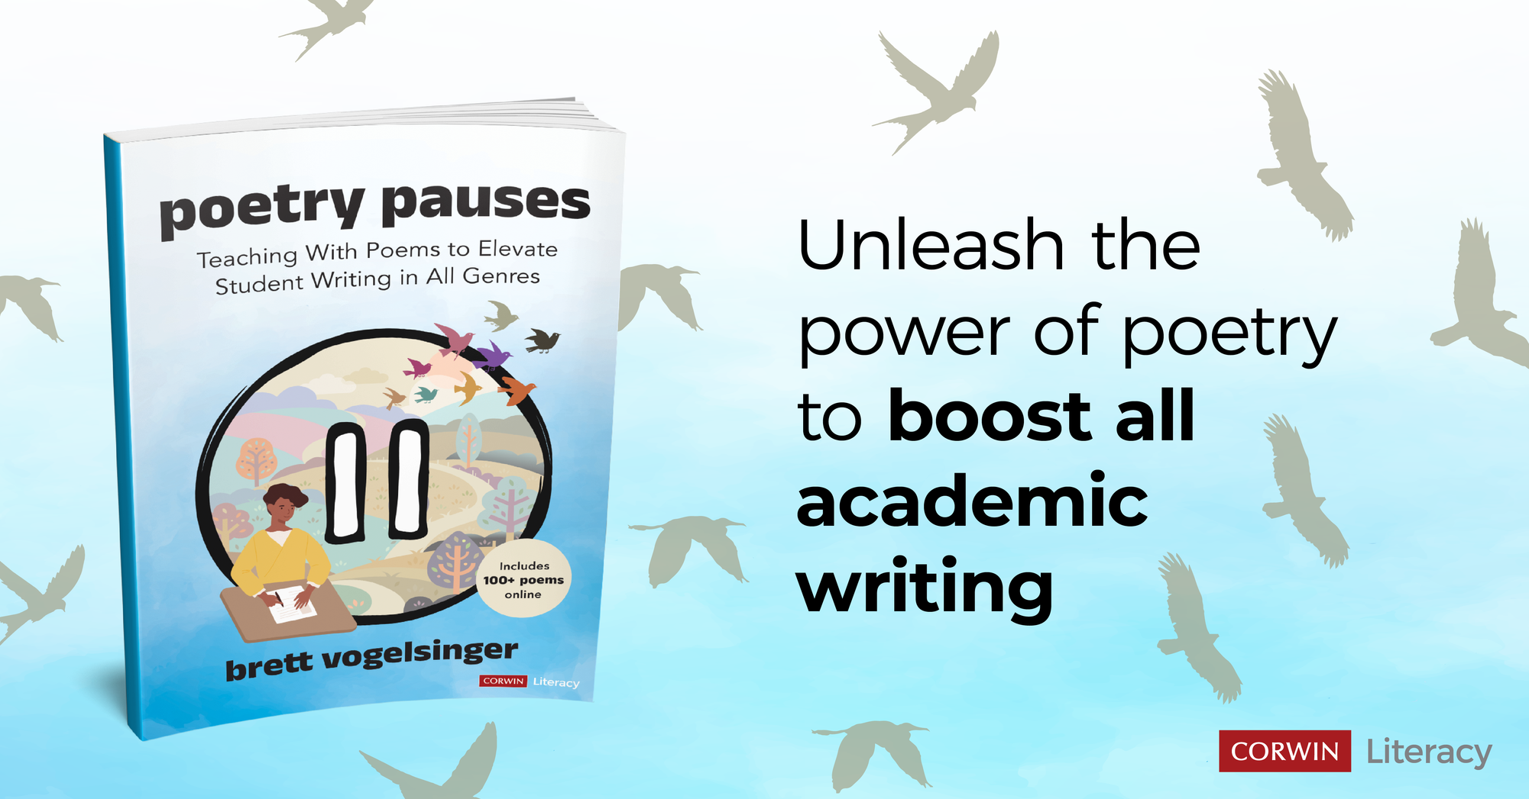

Slide 34

thanks for coming!
KEEP IN TOUCH AT BRETTVOGELSINGER.COM
OR @THEVOGELMAN

