Slide 1
Best Practices in Identification and Programming for Gifted Multilingual Learners
Hannah Kaptur
PAGE Conference 2022

Slide 2
About Me
M.A. Teaching English to Speakers of Other Languages, West Chester University, 2021
M.Ed. Gifted Education, Millersville University, Expected January 2023
K-6 Gifted Support Teacher in southeastern PA for 3 years
Work in highly diverse district with 7% EMLLs (primarily Spanish-speaking)
Fluently bilingual in English / Spanish

Slide 3
Session Goals
Develop awareness of the common barriers leading to under-representation of language learners in gifted programs
Develop awareness of promising practices that may help to increase equity in identification of language learners as gifted
Understand the need for culturally responsive teaching of gifted multilingual learners and identify strategies to effectively serve these students
Reflect upon the strengths and weaknesses of gifted identification and programming for language learners in your setting and plan for ways to foster equity
Best Practices in Identification and Programming for Gifted Multilingual Learners

Slide 4
agenda
Where We Stand 5
Barriers 10
Promising Practices for Identification 12
Promising Practices for Programming 19
Summary 23

Slide 5
Where We Stand

Slide 6
Representation of English Learners (OELA, 2021)
Emerging Multilingual Learners (EMLLs) are the fastest growing population of learners in the United States. However, despite the growing numbers of EMLLs, their representation in gifted identification and programming continues to lag behind not only traditional populations of learners from advantaged communities, but also other underserved populations of learners.
Best Practices in Identification and Programming for Gifted Multilingual Learners

Slide 7
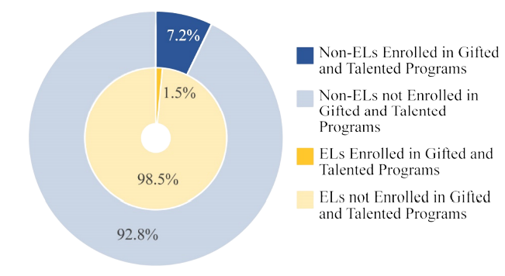
Percentage of English Learners and Non-English Learners in Gifted and Talented Programs: School Year 2017–18 (Office of English Language Acquisition, 2021)
Nationwide, during the 2017–18 school year, EMLLs were only one-fifth as likely as nonEMLLs to participate in a gifted and talented program in K–12 schools
Best Practices in Identification and Programming for Gifted Multilingual Learners

Slide 8
What About Pennsylvania?
All 50 states were ranked according to the percentage of EMLLs who are enrolled in gifted programs, with 1 having the highest percentage of participation and 50 having the lowest. At what number do you think Pennsylvania’s was ranked?
Best Practices in Identification and Programming for Gifted Multilingual Learners

Slide 9
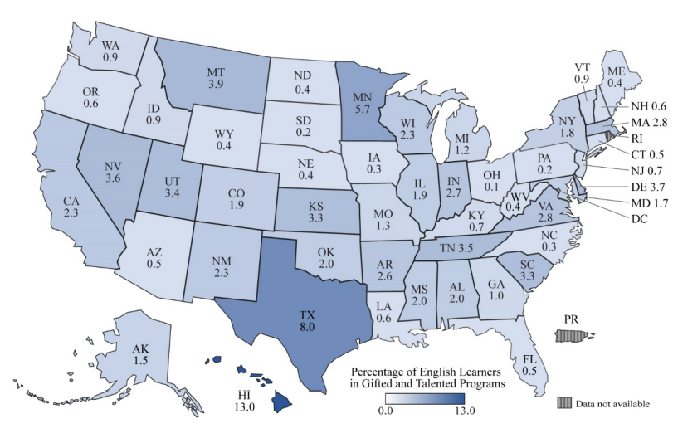
Percentage of Emerging Multilingual Learners in Gifted Programs by State (OELA, 2021)
PA was tied for 49th place, with only 0.2% of EMLLs participating in gifted programs.
Best Practices in Identification and Programming for Gifted Multilingual Learners

Slide 10
Barriers to Equitable Identification

Slide 11
Barriers Include… (Mun et. al., 2016)
School-level policies lagging behind research findings on inclusive identification
Teachers with deficit-thinking biases referring fewer linguistically diverse students
Language proficiency masking true abilities
Culturally biased assessments
Rigid criteria, even when multiple criteria are used, that disqualify based on one factor even when other factors suggest giftedness
Best Practices in Identification and Programming for Gifted Multilingual Learners

Slide 12
Promising Practices for Identification

Slide 13
Universal Screening
Select assessment instruments that are culturally sensitive and account for language differences
Adopt a policy of universal screening of all students in one or more grade levels for the identification
process
Assess the speed of English language acquisition and monitor the rate of mastering reading, writing, listening, and speaking skills in English (Lindo, 2018)
Consider including reliable and valid nonverbal ability assessments as part of the overall identification
process
Use other identification tools to supplement results of universal screening

Slide 14
Key Quote
“Care should be taken that students are given more opportunities through multiple criteria, rather than more hurdles” (Mun et. al., 2016, p. 32).
Best Practices in Identification and Programming for Gifted Multilingual Learners

Slide 15
Alternative Pathways
Use native language ability and achievement assessments as indicators of giftedness, if available
Maintain a list of multilingual school psychologists who are qualified to administer assessments in the student’s native language
Establish a preparation program prior to formal identification procedures that provides students with learning opportunities to enhance knowledge and academic skills necessary for a student to be recognized
Create a talent pool list of students who exhibit high potential but are not yet enrolled in gifted programs. Observations, daily interactions, informal assessments, and formal assessments provide multiple opportunities to gauge learning progress. Make identification an ongoing process, not a single event
Best Practices in Identification and Programming for Gifted Multilingual Learners

Slide 16
Web of Communication
Establish an identification committee that includes representatives who have key responsibilities in various roles and departments
Emphasize collaboration within and across departments (general ed., ESL, gifted, special ed.) so people view themselves as talent scouts
Implement intentional outreach to the community, particularly students’ families, using multiple pathways and languages as appropriate
Best Practices in Identification and Programming for Gifted Multilingual Learners

Slide 17
Professional Development
Provide professional development opportunities for school personnel about effective policies and practices to support equitable representation of EMLLs in gifted programs
Develop a systematic approach to analyzing district and school demographics and the status of students identified/not identified for gifted programs
Promote efforts to diversify the teaching corps so that the adult community of a school reflects the student population
Best Practices in Identification and Programming for Gifted Multilingual Learners

Slide 18
Reflection
Which of these promising
practices does your district or school already incorporate effectively?
2. What are one or two promising practices you could prioritize as areas for improvement that would have the greatest positive impact for gifted EMLLs in your district who are not yet identified?
Best Practices in Identification and Programming for Gifted Multilingual Learners

Slide 19
Promising Practices for Serving Gifted EMLLs

Slide 20
Promising Practices Include… (Kitano & Pederson, 2002; Mun et. al., 2016)
Focus on providing services in areas of strength
Promote opportunities to maintain and develop skills in their native language
Make accommodations for English proficiency to allow students to engage in high level thinking and challenging content right away
Consider options such as cluster grouping, dual language immersion, or bilingual instruction
Best Practices in Identification and Programming for Gifted Multilingual Learners

Slide 21
Promising Practices Include… (Kitano & Pederson, 2002; Mun et. al., 2016)
Purposefully build background knowledge and vocabulary
Use a “windows and mirrors” approach that values students’ cultures while also exposing them to others
Incorporate student interests and experiences into instruction
“Show” instead of “tell” so that verbal demands do not interfere with learning
Best Practices in Identification and Programming for Gifted Multilingual Learners

Slide 22
Reflection
Which of these promising
practices does your district or school already incorporate effectively?
2. What are one or two promising practices you could prioritize as areas for improvement that would have the greatest positive impact for gifted EMLLs in your program?
Best Practices in Identification and Programming for Gifted Multilingual Learners

Slide 23
Summary
Seek to discover and develop talent, rather than expecting gifted EMLLs to meet stringent criteria on their own
View multilingualism and multiculturalism as assets rather than deficits
Make accommodations that allow gifted EMLLs to engage with challenging thinking and content in order to build on their strengths, rather than lessening rigor to focus on basic skills
Best Practices in Identification and Programming for Gifted Multilingual Learners

Slide 24
Questions?
Best Practices in Identification and Programming for Gifted Multilingual Learners

Slide 25
References & Further Research
Castellano, J. A., & Diaz, E. I. (2002). Reaching New Horizons: Gifted and Talented Education for Culturally and Linguistically Diverse Students.
DuBois, M. P., & Greene, R. M. (2021). Supporting Gifted ELLs in the Latinx Community: Practical Strategies, K-12. Routledge, Taylor & Francis Group.
Gubbins, E. J., Siegle, D., Hamilton, R., Peters, P., Carpenter, A. Y., O'Rourke, P., ... & Estepar-Garcia, W. (2018). Exploratory Study on the Identification of English Learners for Gifted and Talented Programs. Grantee Submission.
Gubbins, E. J., Siegle, D., Peters, P. M., Carpenter, A.Y., Hamilton, R., McCoach, D. B., Puryear, J. S., Langley, S. D., & Long, D. (2020). Promising practices for improving identification of English learners for gifted and talented programs. Journal for the Education of the Gifted, 43(4), 336–369. https://doi.org/10.1177/0162353220955241
Hamilton, R., Long, D., McCoach, D. B., Hemmler, V., Siegle, D., Newton, S. D., Gubbins, E. J., & Callahan, C. M. (2020). Proficiency and Giftedness: The Role of Language Comprehension in Gifted Identification and Achievement. Journal for the Education of the Gifted, 43(4), 370–404.
Kitano, M. K., & Pedersen, K. S. (2002). Action Research and Practical Inquiry: Teaching Gifted English Learners. Journal for the Education of the Gifted, 26(2), 132–147.
Lindo, M. (2018). Differences in English Language Proficiency Growth: A Possible Indicator of Giftedness for English Learners [ProQuest LLC]. In ProQuest LLC.
Best Practices in Identification and Programming for Gifted Multilingual Learners

Slide 26
References & Further Research, cont.
Lohman, D. F., Korb, K. A., & Lakin, J. M. (2008). Identifying Academically Gifted English-Language Learners Using Nonverbal Tests: A Comparison of the Raven, NNAT, and CogAT. Gifted Child Quarterly, 52(4), 275–296.
Mun, R. U., Hemmler, V., Langley, S. D., Ware, S., Gubbins, E. J., Callahan, C. M., McCoach, D. B., & Siegle, D. (2020). Identifying and serving English learners in gifted education: Looking back and moving forward. Journal for the Education of the Gifted, 43(4), 297-335. https://doi.org/10.1177/0162353220955230
Mun, R. U., Langley, S. D., Ware, S., Gubbins, E. J., Siegle, D., Callahan, C. M., McCoach, D. B., Hamilton, R., & National Center for Research on Gifted Education (NCRGE). (2016). Effective Practices for Identifying and Serving English Learners in Gifted Education: A Systematic Review of Literature. In Grantee Submission. Grantee Submission.
Office of English Language Acquisition (OELA) (ED). (2021). English Learners in Gifted and Talented Programs. Office of English Language Acquisition, US Department of Education.
Patterson-Davidson, V. L. (2012). The Underrepresentation of English Learners in Mississippi’s Intellectually Gifted Education Program: A Framework for Change [ProQuest LLC]. In ProQuest LLC.
Ruiz de Castilla, V., August, D., & Texas Education Research Center. (2017). Identification of Gifted and Talented English Learner Students in Grades K-5 in Texas: Lessons from Student-Level Data. Policy Brief. In Texas Education Research Center. Texas Education Research Center.
Best Practices in Identification and Programming for Gifted Multilingual Learners

Slide 27
Thank You
Hannah Kaptur
hkaptur@gmail.com

